Slide 1
Learnmate ai
IBM INTERNSHIP PROJECT
AI coach that builds and updates personalized learning paths based on skills and interests.
Presented By -
Student name : Niket Gupta
College Name & Department : KR Mangalam University, BTech CSE AI ML, SOET

Slide 2
OUTLINE
Problem Statement
Technology used
Wow factor
End users
Result
Conclusion
Future scope
IBM Certifications

Slide 3
Problem Statement
Students often struggle to find the right learning path due to an overwhelming number of online resources and lack of personalized guidance.
Proposed Solution:
LearnMate is an agentic AI coach that interacts with students, understands their interests and skill levels, and builds a dynamic, evolving roadmap of courses aligned with their goals.

Slide 4
Technology used
IBM Cloud Lite Services
IBM Watsonx.ai Studio
Granite Foundation Model
LangGraph Framework
ReAct Architecture (Reasoning + Acting)
IBM Cloud Functions
IBM Cloudant (for storing profiles & progress)

Slide 5
IBM cloud services used
Watsonx.ai Studio (LLM prompt design + deployment)
Watsonx.ai Agent Builder
Granite-13b-chat-v2 foundation model
IBM Cloudant (vector data storage)
IBM Cloud Functions (logic engine)

Slide 6
Wow factors
LearnMate significantly reduces the time and effort students spend navigating vast online learning resources. It enhances the quality of self-learning by providing structured, personalized roadmaps tailored to individual goals and skill levels. This AI-powered agent empowers learners with clarity, direction, and adaptability, fostering continuous upskilling and career alignment.
Unique features:
Personalized course pathways based on interests, skill level, and career goals
Real-time skill assessment and dynamic roadmap adjustments
AI-curated course recommendations from trusted learning platforms
Progress-aware learning plans that evolve with the user
Domain-specific learning (e.g., Cybersecurity, Frontend Development, UI/UX)
Roadmap regeneration based on completed tasks or updated preferences

Slide 7
End users
Students and Self-learners
Career Switchers
Colleges and Universities
EdTech Platforms

Slide 8
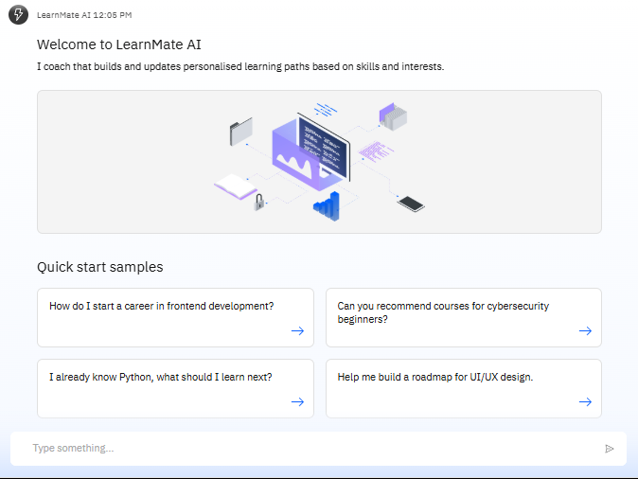
Results

Slide 9
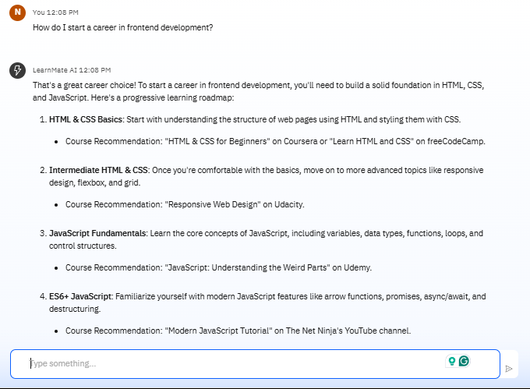
Results
.

Slide 10
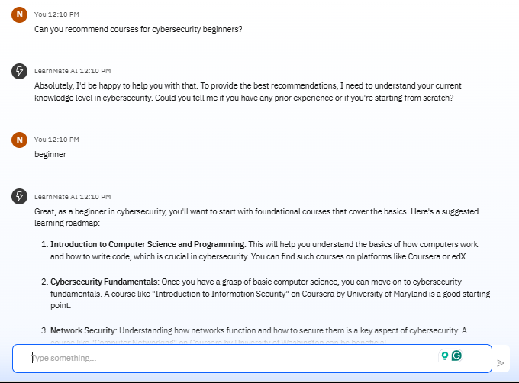
Results

Slide 11
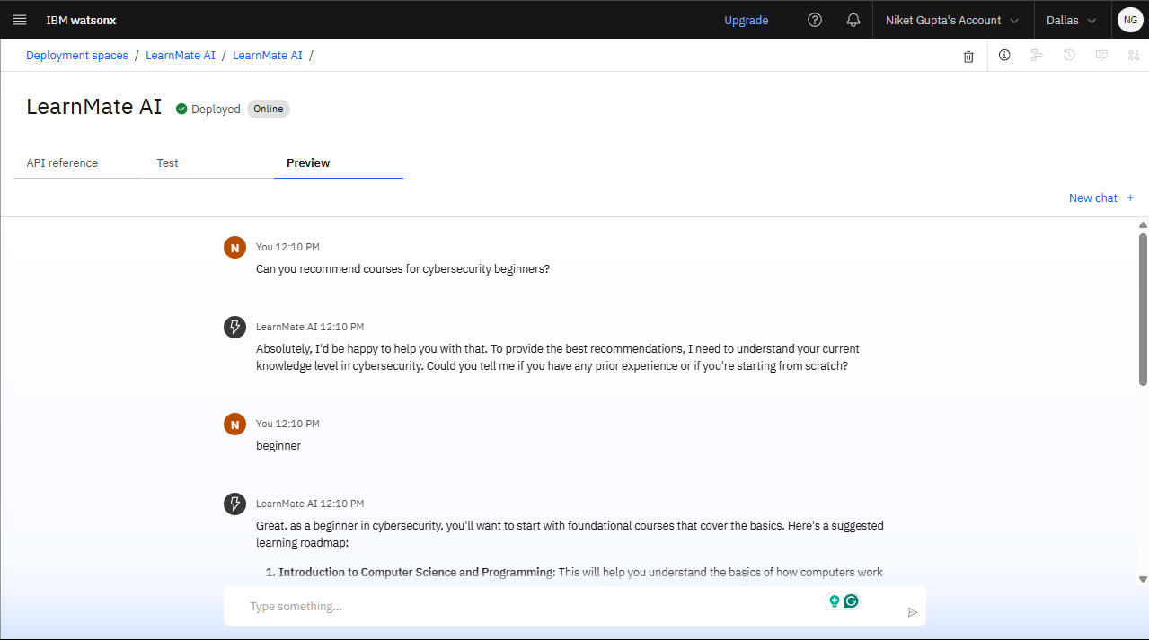
Results
Deployed AI Agent

Slide 12
Conclusion
LearnMate enhances student learning experiences by providing structured, AI-curated course plans.
It minimizes confusion, saves time, and empowers users to stay on track in their upskilling journey.

Slide 13
GITHUB LINK
.
https://github.com/NiketGupta06/LearnMate-AI

Slide 14
Future scope
Voice-based interactions (multimodal agent)
Integration with real APIs (Coursera, edX, etc.)
Real-time progress tracking dashboard
Memory-based personalization (long-term profile history)
Support for regional languages

Slide 15
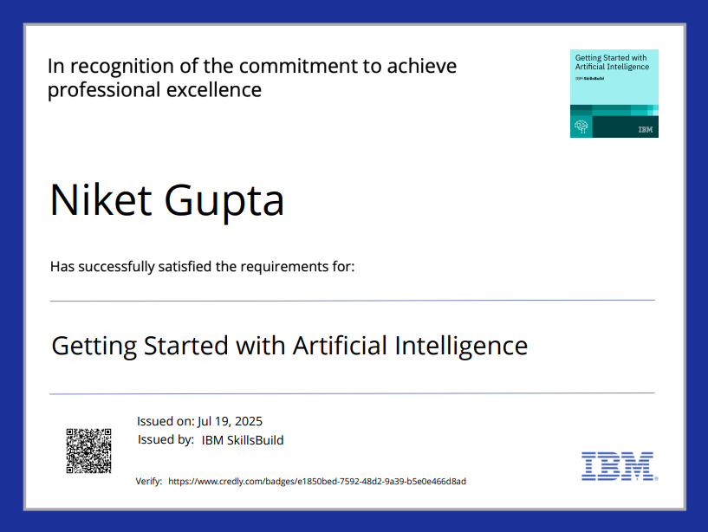
IBM Certifications
.

Slide 16
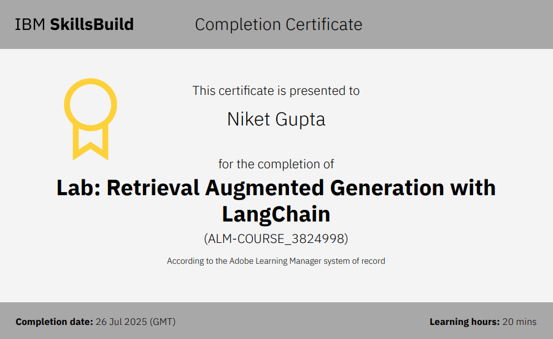

Slide 17
THANK YOU
Guiding learning paths with AI — one student at a time.

